Slide 2
The 7 C’s of Effective Technical Writing

Slide 3
Effective Writing is
Clear
Coherent
Concise
Concrete
Correct
Courteous
Complete

Slide 4

“CLEAR writing conveys the purpose of the document immediately to the reader”
How do we build clarity into our writing?
Notes:
http://educredservices.com/blog/2015/1/6/a-time-to-re-focus-new-year-new-vision-renewed-commitment

Slide 5
Build clarity by
Planning: know what you want to say
Know your audience: understand their needs
Match vocabulary to audience: write to EXPRESS, not impress
Choose effective sentence structures
Construct unified paragraphs

Slide 6
Clear Paragraph Construction: TEEC
T: Topic Sentence controls the entire paragraph
E: Examples and Evidence to support your topic
E: Explain how your evidence supports ideas
C: Conclude logically

Slide 7

COHERENT writing ensures that the reader can easily follow your ideas and your train of thought. One idea leads logically to the next without leaving gaps that confuse the reader.
How do we build coherence into our writing?
Notes:
http://www.ourclipart.com/clipart/cohesion%20clipart/#gal_cohesion-clipart_2685453.jpg

Slide 8
Build Coherence by
Using logical transitions to link sentences
Organizing document information logically
Strategic repetition
Using parallel construction

Slide 9

CONCISE writing uses the least words possible to convey the most meaning while still maintaining clarity.
How can we improve conciseness in our writing?

Slide 10
Be Concise by
Avoiding meaningless padding and unnecessary repetition
Avoid vague generalities, tired clichés, and awkward phrasing (eg: passive verb constructions)
Avoid stating the perfectly obvious
Think of your word count like a budget: cut a word, save a buck!

Slide 11
Revise the following to be more concise:
Energy drinks may be consumed in many different ways. Drinking energy drinks can provide the helpful benefits of increased awareness and energy. However, even with the enhancements that may arise from drinking an energy drink, there may be ill effects which pose more of a threat to a person than the energy boost that a person may receive.

Slide 12
Rethink the topic sentence:
Energy drinks may be consumed in many different ways. Drinking energy drinks can provide the helpful benefits of increased awareness and energy. However, even with the enhancements that may arise from drinking an energy drink, there may be ill effects which pose more of a threat to a person than the energy boost that a person may receive.
Cut meaningless padding!

Slide 13
Cut repetition
Drinking energy drinks can provide the helpful benefits of increased awareness and energy. However, even with the enhancements that may arise from drinking an energy drink, but there may be ill effects which pose more of a threat to a person than the energy boost that a person may receive.
Get to the point! Don’t waste your reader’s time.

Slide 14
Revised versions:
Simple Sentence: | The negative effects of energy drinks outweigh the benefits.
Compound Sentence | Energy drinks can increase awareness and energy; however, they can also cause harmful side effects.
Complex Sentence | Although energy drinks can increase awareness and energy, they can have negative effects that outweigh these benefits

Slide 15

CONCRETE writing involves using specific, precise language to paint a picture for your readers so that they can more easily understand your ideas.
How can we improve the precision of our writing?

Slide 16
Be Concrete by
Avoiding abstract words – or if you must use them, define them using concrete examples
Find the most precise word to express your idea
Use measurable terms whenever possible
Choose words that create pictures in the reader’s mind

Slide 17

CORRECT writing, in terms of both grammar and factual accuracy, can determine your effectiveness and credibility.
How can we improve the correctness of our writing?

Slide 18
Be Correct by
Checking your facts and verifying information before passing it along
Using reliable sources for information
Reviewing grammar rules as necessary
Having a peer review what you have written

Slide 19
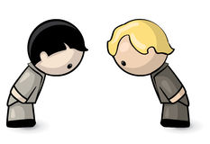
Courteous communication is user-friendly, constructive, tactful, open, and honest. It is mindful of potential cultural or social differences.
How can we improve the courtesy of our writing?

Slide 20
Be Courteous by
Taking the time to understand your audience and their needs (for content, language, style, and format)
Designing user-friendly documents
Being constructive, tactful, open, and honest
Being mindful of cultural and social differences
Using gender-neutral language

Slide 21

Complete communication includes all requested information, meets all requirements, and answers all relevant questions.
How can we improve the completeness of our writing?

Slide 22
Be Complete by
Re-checking requirements and specifications before submitting work
Asking someone to review your document for gaps you might not see
Leaving sufficient time for review

Slide 23
Other C’s to keep in mind
CREATIVE
CREDIBLE
CONSTRUCTIVE

Slide 24
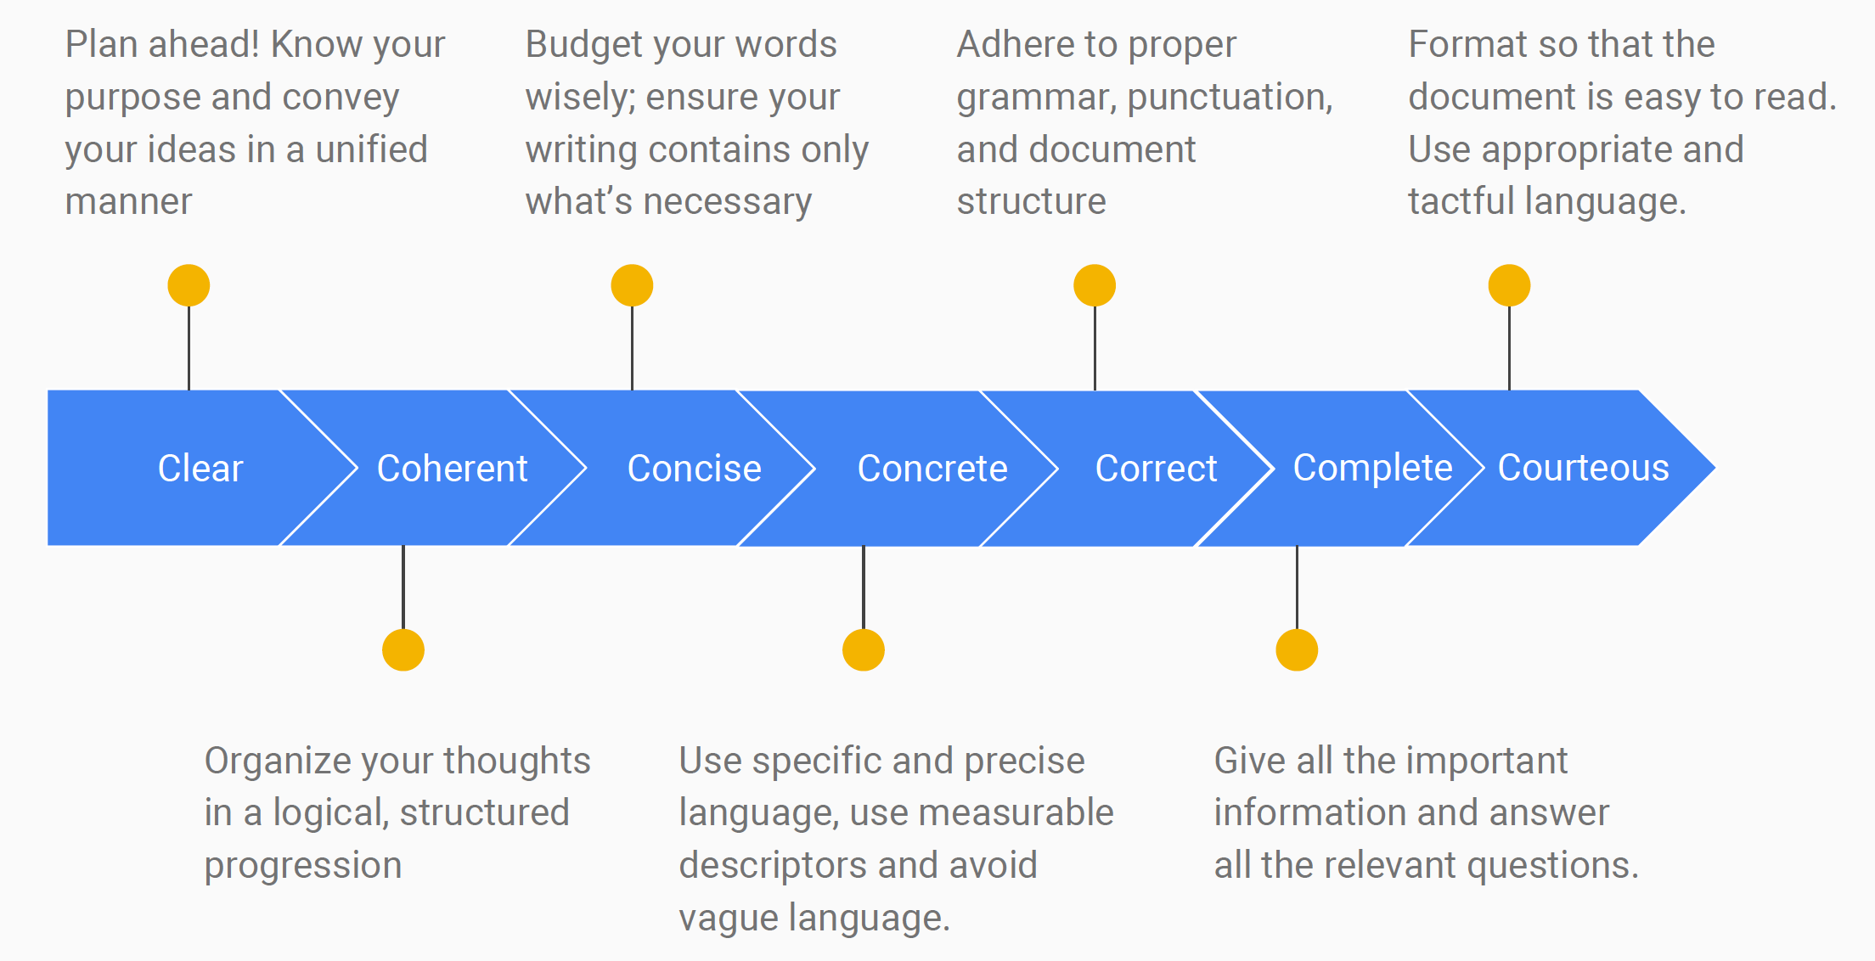
Written work is evaluated on how well it adheres to the 7 Cs

Slide 25
The 7 C’s of Technical Writing
Clear
Complete
Coherent
Credible
Courteous
Concise
Correct
Concrete

